Slide 1

Predicting Heart Disease Risk: Analyzing Health and Socio-Economic Indicators (Assignment 3) Aisha Mohammad

Slide 2

Contents:
Key Goals.
Data Pre processing.
Model development overview.
Model evaluations – key observations.
Model comparison summary.

Slide 3

KEY GOALS
Utilize the new ‘combined’ dataset (after undersampling) with (1190, 34) shape.
To implement 4 Machine Learning models: Logistic Regression, Random Forest, Gradient Boosting, SVM
Evaluate the performance of the models using metrics such as key evaluation metrics :
Accuracy, Precision, AUC/ROC, MAE, MSE, RMSE, MAPE.
Compare the models performances.
Problem statement : prediction of heart disease risk by examining both clinical health indicators and socioeconomic determinants.
The target variable is binary. Whether patients have heart disease or not.

Slide 4
Data pre processing
Tecnhniques applied for data pre processing :
Feature Engineering : The target variable of dataset 1 ‘Target’ and a feature variable conating similar data ‘HeartDiseaseorAttack’ were merged to a new target variable.
Imbalanced Data Handling : The new target variable was imbalanced. So SMOTE was applied to balance the data.
Feature Selection : 4 techniques were used to select most relevant features.
Correlation matrix
Point-biserial correlation
Random Forest classifier
RFE - using Logistic Regression
Results from Random Forest classifier aligned with my socio-economic goals. These were selected.
Features not required for this analysis were dropped.

Slide 5
Model developments Overview
Using function- based coding 4 models were developed:
Logistic Regression:
A type of regression analysis used for prediction of outcome variables that are binary.
Efficient and requires less computational power. Can perform well with linearly separable data.
Random Forest (RF):
A decision-tree-based ensemble algorithm that combines multiple decision trees to make predictions.
Handles large datasets and missing values well. Also is robust to overfitting and works well with a mix of continuous and categorical data.
Gradient Boosting :
An algorithm that involves sequentially training weak models (typically decision trees) where each new model corrects the errors made by the previous one.
Can achieve high performance on both classification and regression tasks. Also, handles imbalanced datasets better with tuning.
SVM :
A powerful classifier that aims to find a hyperplane in an n-dimensional space that separates the data points of different classes.
Effective in high-dimensional spaces, especially useful in cases where the number of dimensions exceeds the number of samples.

Slide 6
MODEL evaluation - Key observations
Logistic Regression
Accuracy: Moderate at 0.739.
Precision: Low at 0.222, indicating many false positives.
AUC/ROC: Fair at 0.728, showing acceptable but not strong classification performance.
Error Metrics: High MAE, MSE, and RMSE compared to others suggest less accurate predictions.
Suitability: Poor performance overall; not the best model here.
2. Random Forest:
Accuracy: High at 0.882, the best among all models.
Precision: Moderate at 0.429, better than Logistic Regression.
AUC/ROC: Good at 0.792, indicating strong classification performance.
Error Metrics: Lowest MAE, MSE, and RMSE, implying high prediction accuracy.
Suitability: Excellent model performance; likely the best choice.

Slide 7
3. Gradient Boosting:
Accuracy: High at 0.882, the best among all models.
Precision: Moderate at 0.429, better than Logistic Regression.
AUC/ROC: Good at 0.792, indicating strong classification performance.
Error Metrics: Lowest MAE, MSE, and RMSE, implying high prediction accuracy.
Suitability: Excellent model performance; likely the best choice.
4. SVM:
Accuracy: Moderate at 0.769.
Precision: Low at 0.241, better than Logistic Regression but not ideal.
AUC/ROC: Acceptable at 0.700 but the lowest among all models.
Error Metrics: Higher MAE, MSE, and RMSE compared to Random Forest and Gradient Boosting.
Suitability: Moderate performance; not as strong as Random Forest or Gradient Boosting.

Slide 8
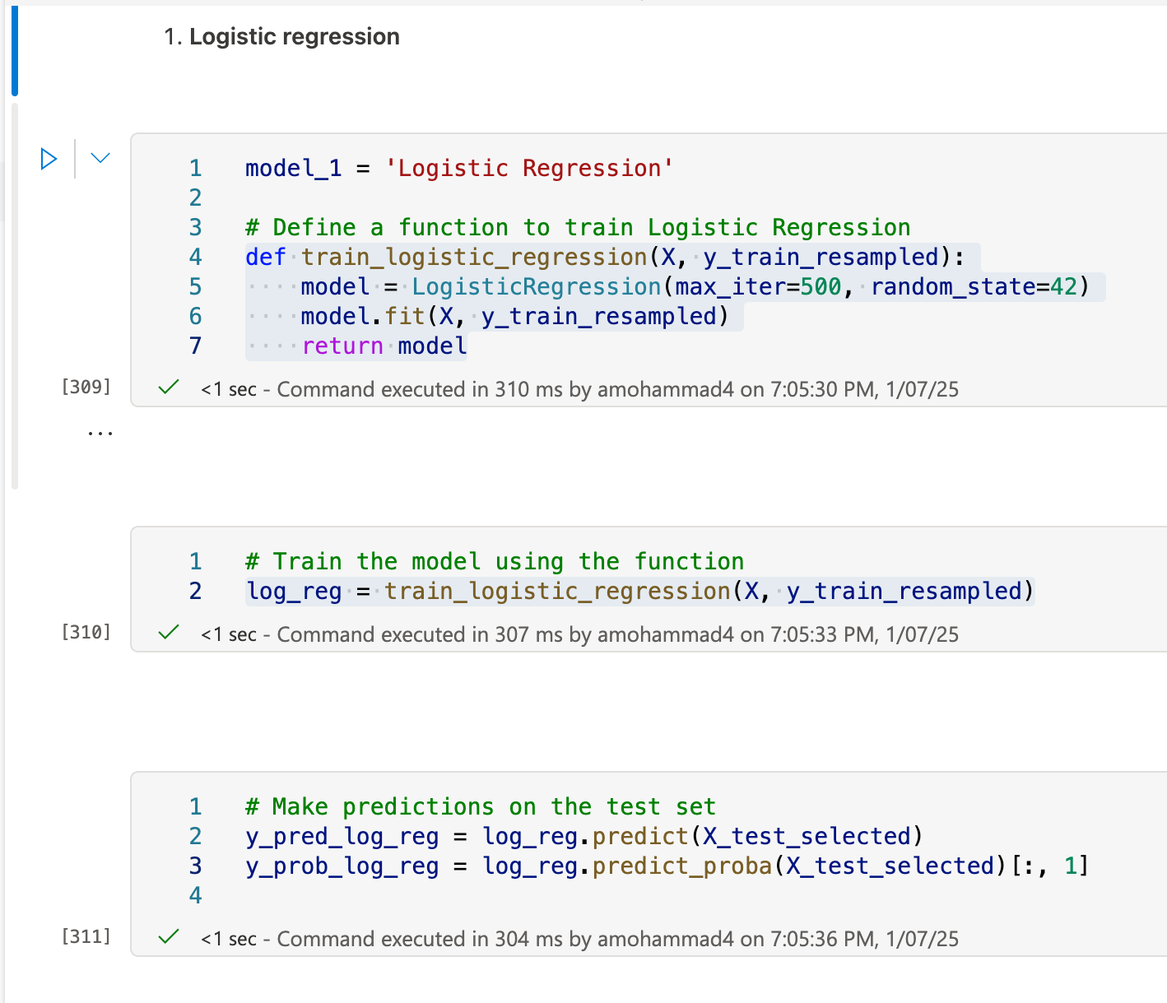
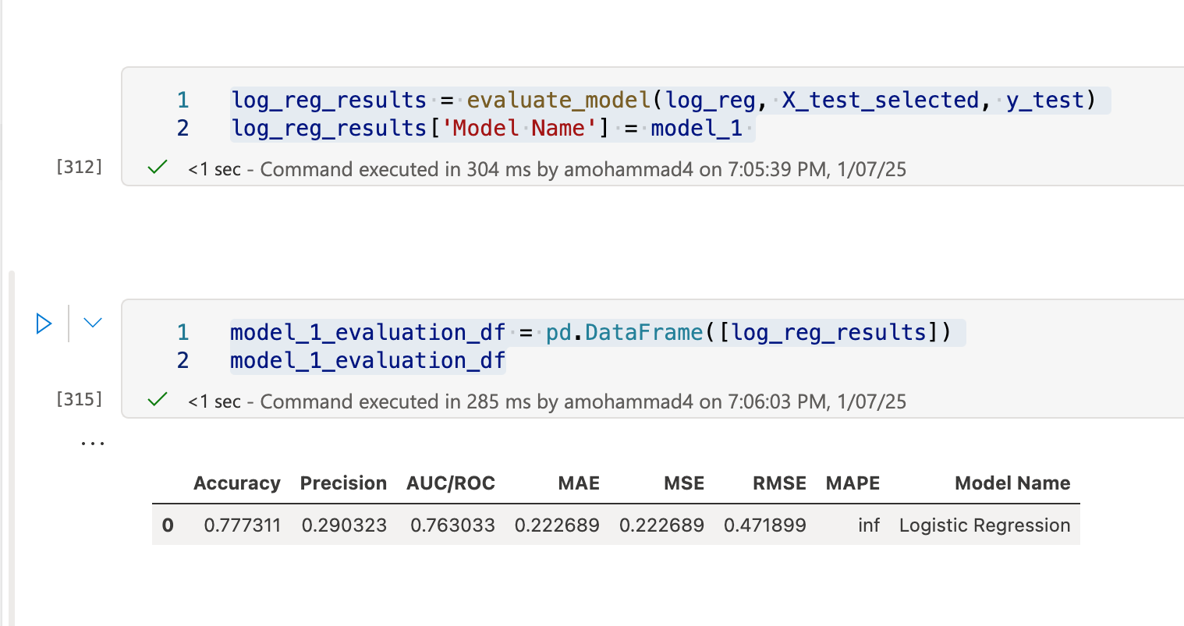
CODE SNIPPETS
Logistic regression

Slide 9
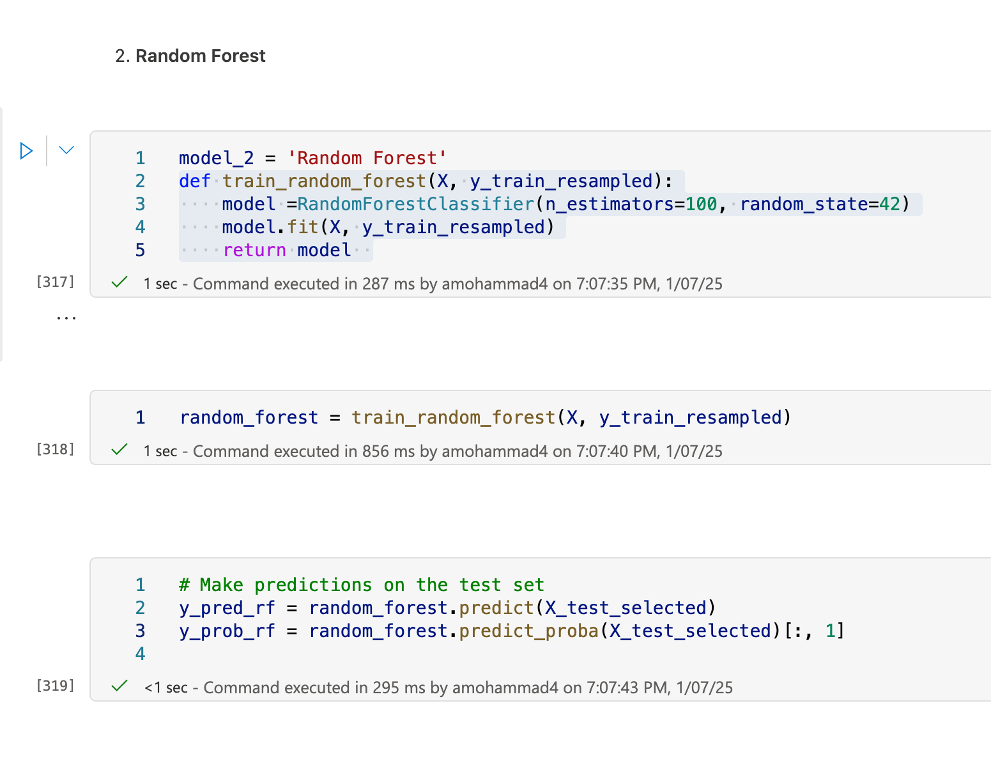
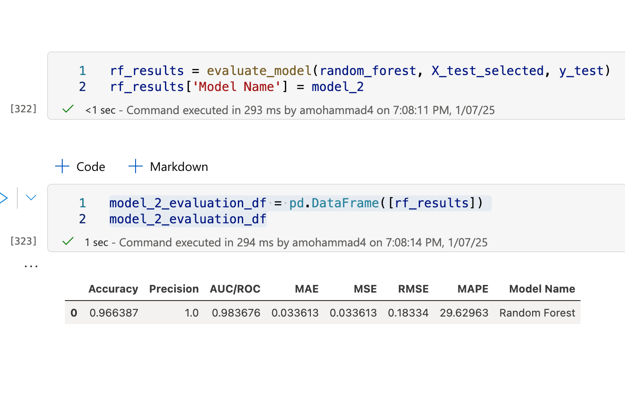
Code snippets
Random Forest classification

Slide 10
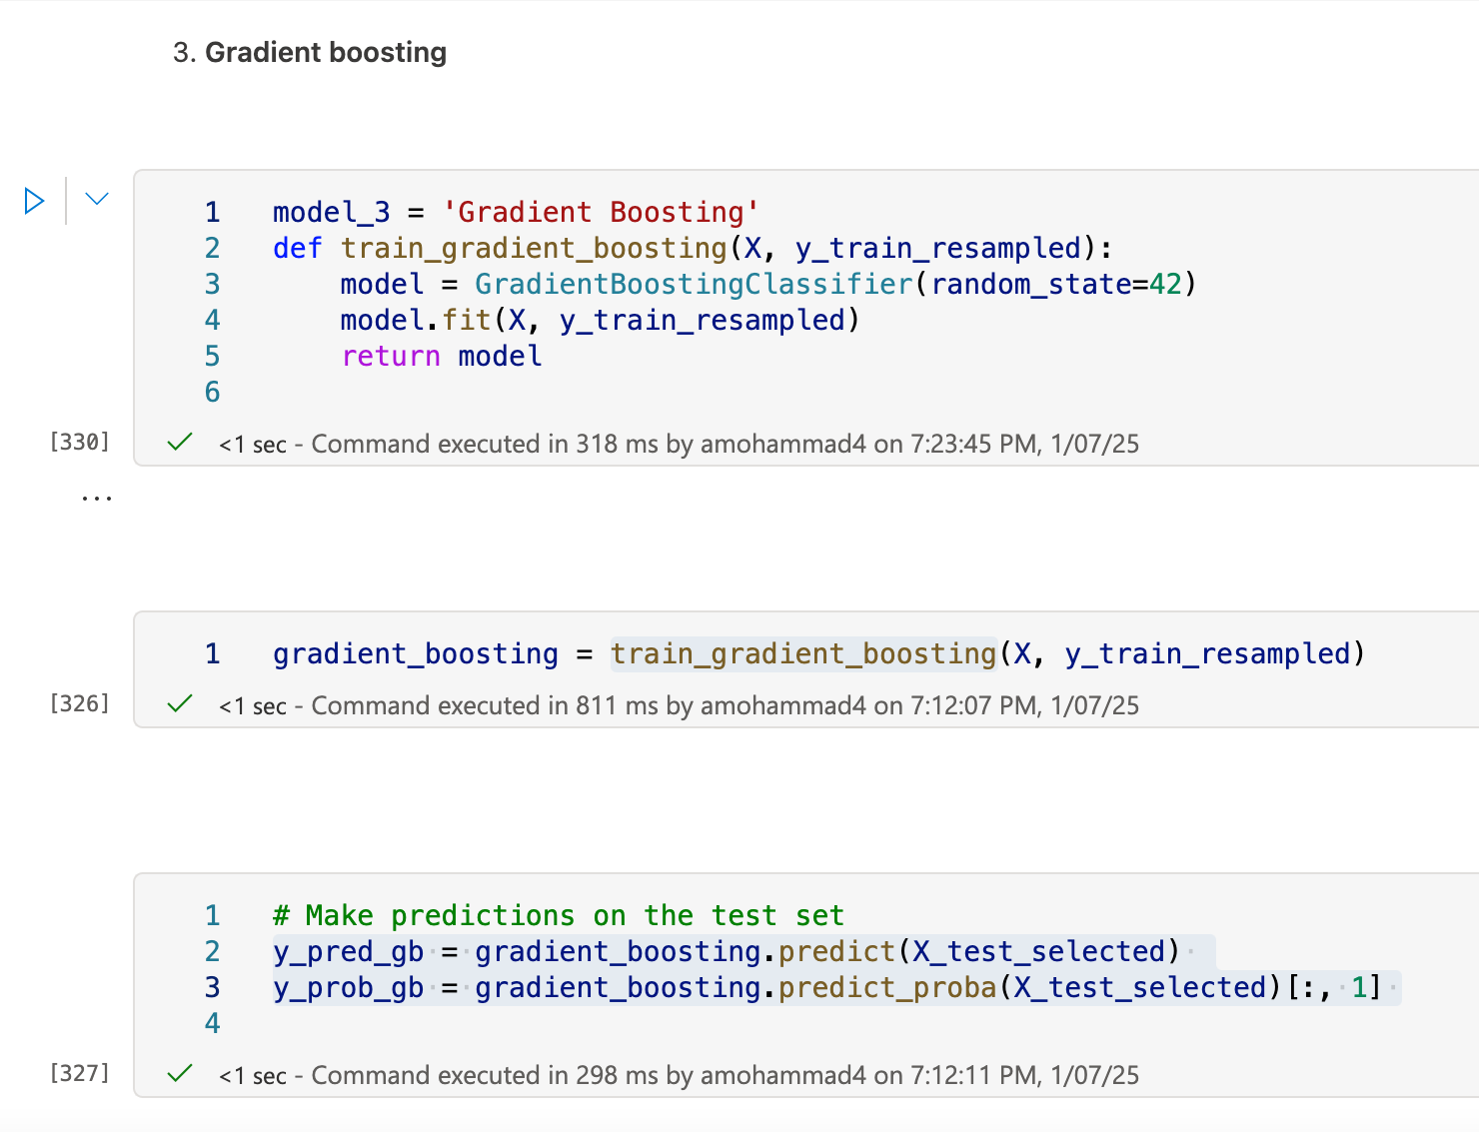
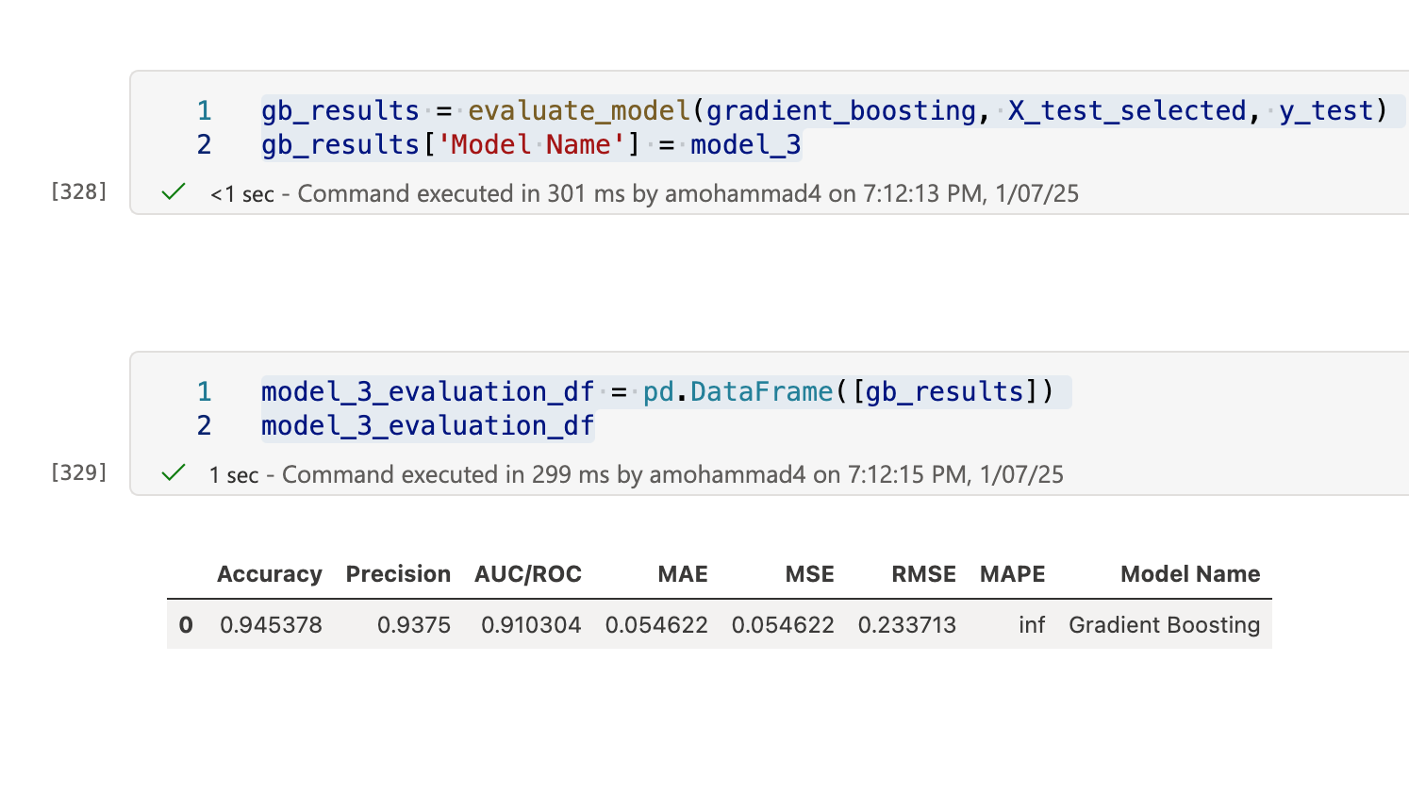
CODE SNIPPETS
Gradient boosting

Slide 11
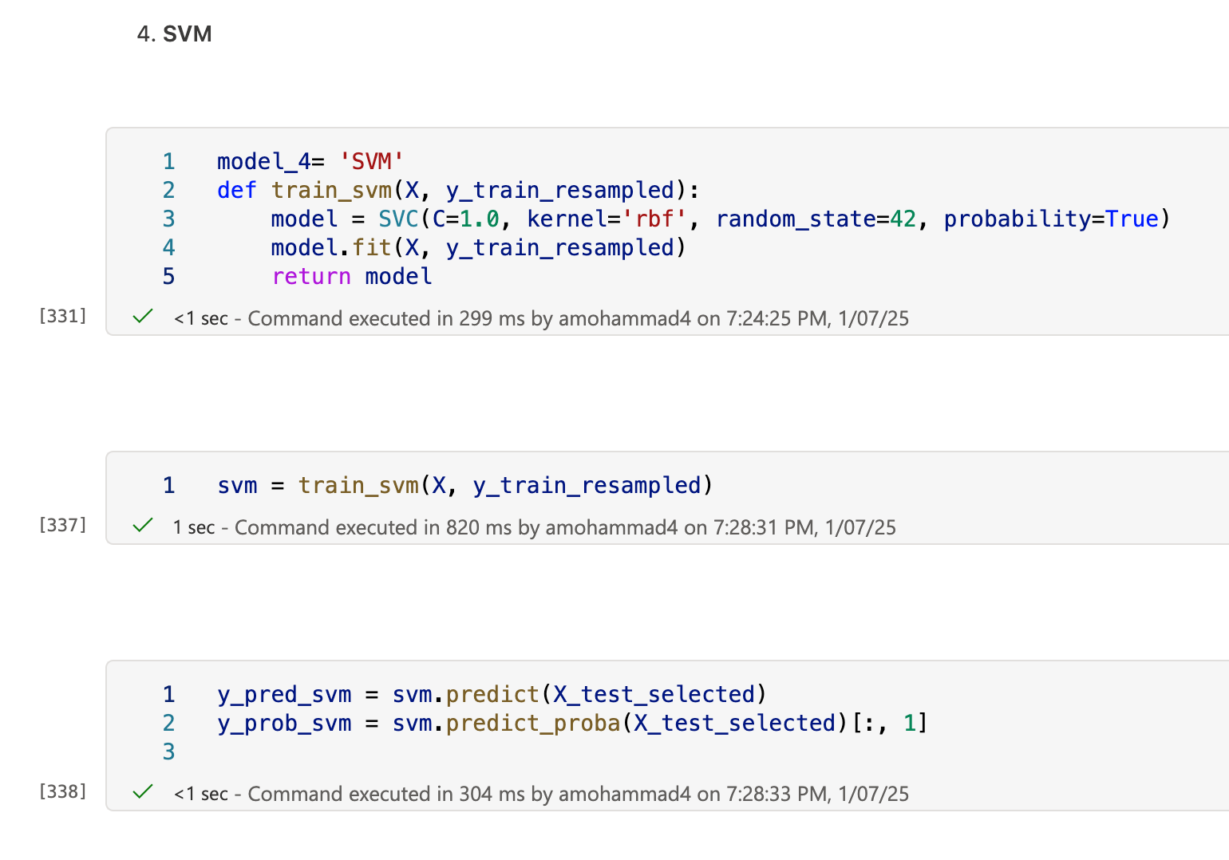
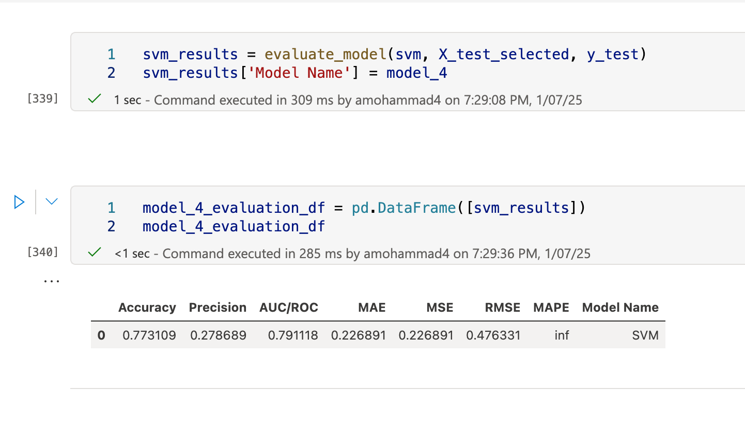
Code snippets
SVM

Slide 12
MODEL COMPARISION SUMMARY
Best Model: Random Forest due to its high accuracy, precision, and AUC/ROC.
Runner-up: Gradient Boosting, with high precision but slightly lower performance compared to Random Forest.
Moderate Performance: Logistic Regression with good accuracy but low precision.
Underperforming Model: SVM due to low precision and higher error metrics.

Slide 13
Tools :-
LINKS:-
Zotero
GitHub
Azure ML – notebooks
Jira – Gantt chart
MVP code Capstone MVP.ipynb - Azure Machine Learning
Capstone project code Capstone.ipynb - Azure Machine Learning
GitHub https://github.com/Aisha-datatech/Capstone-Project
Jira
https://saintpeters-team-hisfhzp1.atlassian.net/jira/core/projects/DTP/timeline?rangeMode=weeks&atlOrigin=eyJpIjoiZTI2YzQwYWQ4ZjcwNGY1ZWIyMGQ2YzU0YWY0NzRlYjEiLCJwIjoiaiJ9

